Slide 1
Syntax analysis in CC
By
Attia Agha

Slide 2
Overview
Phases of CC
Lexical Analysis: The first phase of a compiler is lexical analysis, also known as scanning. This phase reads the source code and breaks it into a stream of tokens, which are the basic units of the programming language. The tokens are then passed on to the next phase for further processing.
Syntax Analysis: The second phase of a compiler is syntax analysis, also known as parsing. This phase takes the stream of tokens generated by the lexical analysis phase and checks whether they conform to the grammar of the programming language. The output of this phase is usually an Abstract Syntax Tree (AST).
Semantic Analysis: The third phase of a compiler is semantic analysis. This phase checks whether the code is semantically correct, i.e., whether it conforms to the language’s type system and other semantic rules. In this stage, the compiler checks the meaning of the source code to ensure that it makes sense. The compiler performs type checking, which ensures that variables are used correctly and that operations are performed on compatible data types. The compiler also checks for other semantic errors, such as undeclared variables and incorrect function calls.

Slide 3
CONT.
Intermediate Code Generation: The fourth phase of a compiler is intermediate code generation. This phase generates an intermediate representation of the source code that can be easily translated into machine code.
Optimization: The fifth phase of a compiler is optimization. This phase applies various optimization techniques to the intermediate code to improve the performance of the generated machine code.
Code Generation: The final phase of a compiler is code generation. This phase takes the optimized intermediate code and generates the actual machine code that can be executed by the target hardware

Slide 4
Introduction
When an input string (source code or a program in some language) is given to a compiler, the compiler processes it in several phases, starting from
lexical analysis (scans the input and divides it into tokens) to target code generation
Syntax Analysis or Parsing is the second phase, i.e. after lexical analysis.
It checks the syntactical structure of the given input, i.e. whether the given input is in the correct syntax (of the language in which the input has been written) or not. It does so by building a data structure, called a Parse tree or Syntax tree.

Slide 5
Cont.
The parse tree is constructed by using the pre-defined Grammar of the language and the input string. If the given input string can be produced with the help of the syntax tree (in the derivation process), the input string is found to be in the correct syntax. if not, the error is reported by the syntax analyzer.
Syntax analysis, also known as parsing, is a process in compiler design where the compiler checks if the source code follows the grammatical rules of the programming language. This is typically the second stage of the compilation process, following lexical analysis
The main goal of syntax analysis is to create a parse tree or abstract syntax tree (AST) of the source code, which is a hierarchical representation of the source code that reflects the grammatical structure of the program

Slide 6
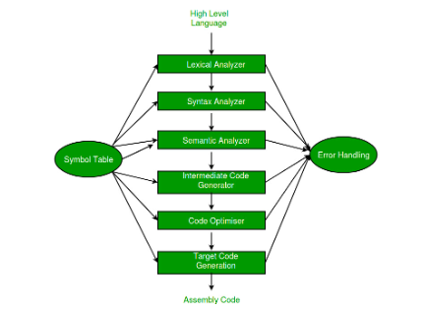
Syntax Analyzer
It is sometimes called a parser. It constructs the parse tree. It takes all the tokens one by one and uses Context-Free Grammar to construct the parse tree

Slide 7
There are several types of parsing algorithms used in syntax analysis, including:
LL parsing: This is a top-down parsing algorithm that starts with the root of the parse tree and constructs the tree by successively expanding non-terminals. LL parsing is known for its simplicity and ease of implementation.
LR parsing: This is a bottom-up parsing algorithm that starts with the leaves of the parse tree and constructs the tree by successively reducing terminals. LR parsing is more powerful than LL parsing and can handle a larger class of grammars.
LR(1) parsing: This is a variant of LR parsing that uses lookahead to disambiguate the grammar.

Slide 8
LALR parsing: This is a variant of LR parsing that uses a reduced set of lookahead symbols to reduce the number of states in the LR parser.
Once the parse tree is constructed, the compiler can perform semantic analysis to check if the source code makes sense and follows the semantics of the programming language.
The parse tree or AST can also be used in the code generation phase of the compiler design to generate intermediate code or machine code.

Slide 9
Features of syntax analysis
Syntax Trees: Syntax analysis creates a syntax tree, which is a hierarchical representation of the code’s structure. The tree shows the relationship between the various parts of the code, including statements, expressions, and operators.
Context-Free Grammar: Syntax analysis uses context-free grammar to define the syntax of the programming language. Context-free grammar is a formal language used to describe the structure of programming languages.
Top-Down and Bottom-Up Parsing: Syntax analysis can be performed using two main approaches: top-down parsing and bottom-up parsing. Top-down parsing starts from the highest level of the syntax tree and works its way down, while bottom-up parsing starts from the lowest level and works its way up.

Slide 10
Feature cont.
Error Detection: Syntax analysis is responsible for detecting syntax errors in the code. If the code does not conform to the rules of the programming language, the parser will report an error and halt the compilation process.
Intermediate Code Generation: Syntax analysis generates an intermediate representation of the code, which is used by the subsequent phases of the compiler. The intermediate representation is usually a more abstract form of the code, which is easier to work with than the original source code.
Optimization: Syntax analysis can perform basic optimizations on the code, such as removing redundant code and simplifying expressions.

Slide 11
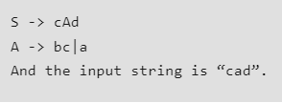
The pushdown automata (PDA) is used to design the syntax analysis phase.
The Grammar for a Language consists of Production rules.
Example: Suppose Production rules for the Grammar of a language are:
Now the parser attempts to construct a syntax tree from this grammar for the given input string. It uses the given production rules and applies those as needed to generate the string. To generate string “cad” it uses the rules as shown in the given diagram:

Slide 12
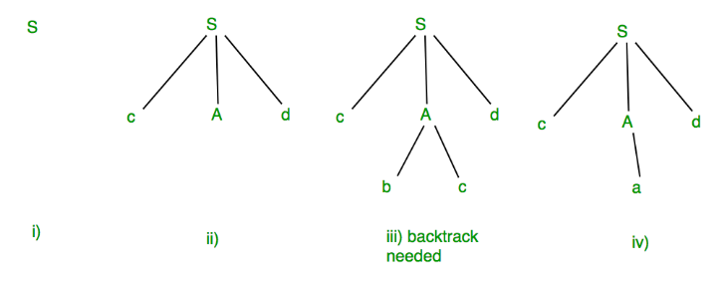
In step (iii) above, the production rule A->bc was not a suitable one to apply (because the string produced is “cbcd” not “cad”), here the parser needs to backtrack, and apply the next production rule available with A which is shown in step (iv), and the string “cad” is produced.
Thus, the given input can be produced by the given grammar, therefore the input is correct in syntax. But backtrack was needed to get the correct syntax tree, which is really a complex process to implement.
There can be an easier way to solve this,“Concepts of FIRST and FOLLOW sets in CC”.

Slide 13
Advantages
Advantages of using syntax analysis in compiler design include:
Structural validation: Syntax analysis allows the compiler to check if the source code follows the grammatical rules of the programming language, which helps to detect and report errors in the source code.
Improved code generation: Syntax analysis can generate a parse tree or abstract syntax tree (AST) of the source code, which can be used in the code generation phase of the compiler design to generate more efficient and optimized code.
Easier semantic analysis: Once the parse tree or AST is constructed, the compiler can perform semantic analysis more easily, as it can rely on the structural information provided by the parse tree or AST

Slide 14
Syntax analysis
Syntax analysis, also known as parsing, is a crucial stage in the process of compiling a program. Its primary task is to analyze the structure of the input program and check whether it conforms to the grammar rules of the programming language. This process involves breaking down the input program into a series of tokens and then constructing a parse tree or abstract syntax tree (AST) that represents the hierarchical structure of the program.
The syntax analysis phase typically involves the following steps:
Tokenization: The input program is divided into a sequence of tokens, which are basic building blocks of the programming language, such as identifiers, keywords, operators, and literals.
Parsing: The tokens are analyzed according to the grammar rules of the programming language, and a parse tree or AST is constructed that represents the hierarchical structure of the program.
Error handling: If the input program contains syntax errors, the syntax analyzer detects and reports them to the user, along with an indication of where the error occurred.

Slide 15
Cont.
Symbol table creation: The syntax analyzer creates a symbol table, which is a data structure that stores information about the identifiers used in the program, such as their type, scope, and location.
The syntax analysis phase is essential for the subsequent stages of the compiler, such as semantic analysis, code generation, and optimization. If the syntax analysis is not performed correctly, the compiler may generate incorrect code or fail to compile the program altogether.
Overall, syntax analysis is a critical stage in the process of compiling a program, as it ensures that the program is syntactically correct and ready for further processing by the compiler.

